Slide 1
Writing a Synthesis Essay
Recognizing Complexity
and
Formulating Your Position

Slide 2
Topic of Conversation
Now that you have read the sources on mandatory community service, let’s walk through the process of synthesizing sources and formulating a position.

Slide 3
Recognizing Complexity
As you move from reading and analyzing the sources to integrating them into your own writing, you will engage in a process of selection.
This is often a complex step in which, ideally, you explore the individual texts and start to see connections among them.
Essential to this process is your willingness to understand each text on its own terms, even if you disagree with the ideas or position; in fact, texts that present viewpoints different from those you initially hold are often the ones that become most important to the development of your argument.

Slide 4
Recognizing Complexity
The fact is, you can rarely change a reader’s mind, at least not radically or immediately.
Instead, what you want to aim for is a compelling argument that leaves the reader thinking, questioning, considering, and reconsidering.

Slide 5
Beyond a Shouting Match
To do this, you have to acknowledge that the issue at hand is a complex one with no easy solutions and a variety of valid perspectives on the matter.
You want to present a reasonable idea in a voice that is logical, sincere, and informed.
To write a qualified argument, you must anticipate objections to your position and recognize and respect the complexities of your topic.
A reasonable voice recognizes that there are more than two sides to an issue-more than pro-con, which is the written equivalent of a shouting match.

Slide 6
Community Passages
Careful reading has already revealed some of the complexities surrounding the issue of mandatory community service in schools.
Let’s explore a few…

Slide 7
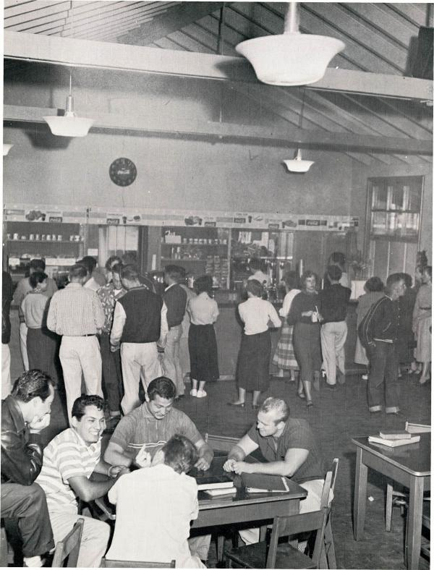
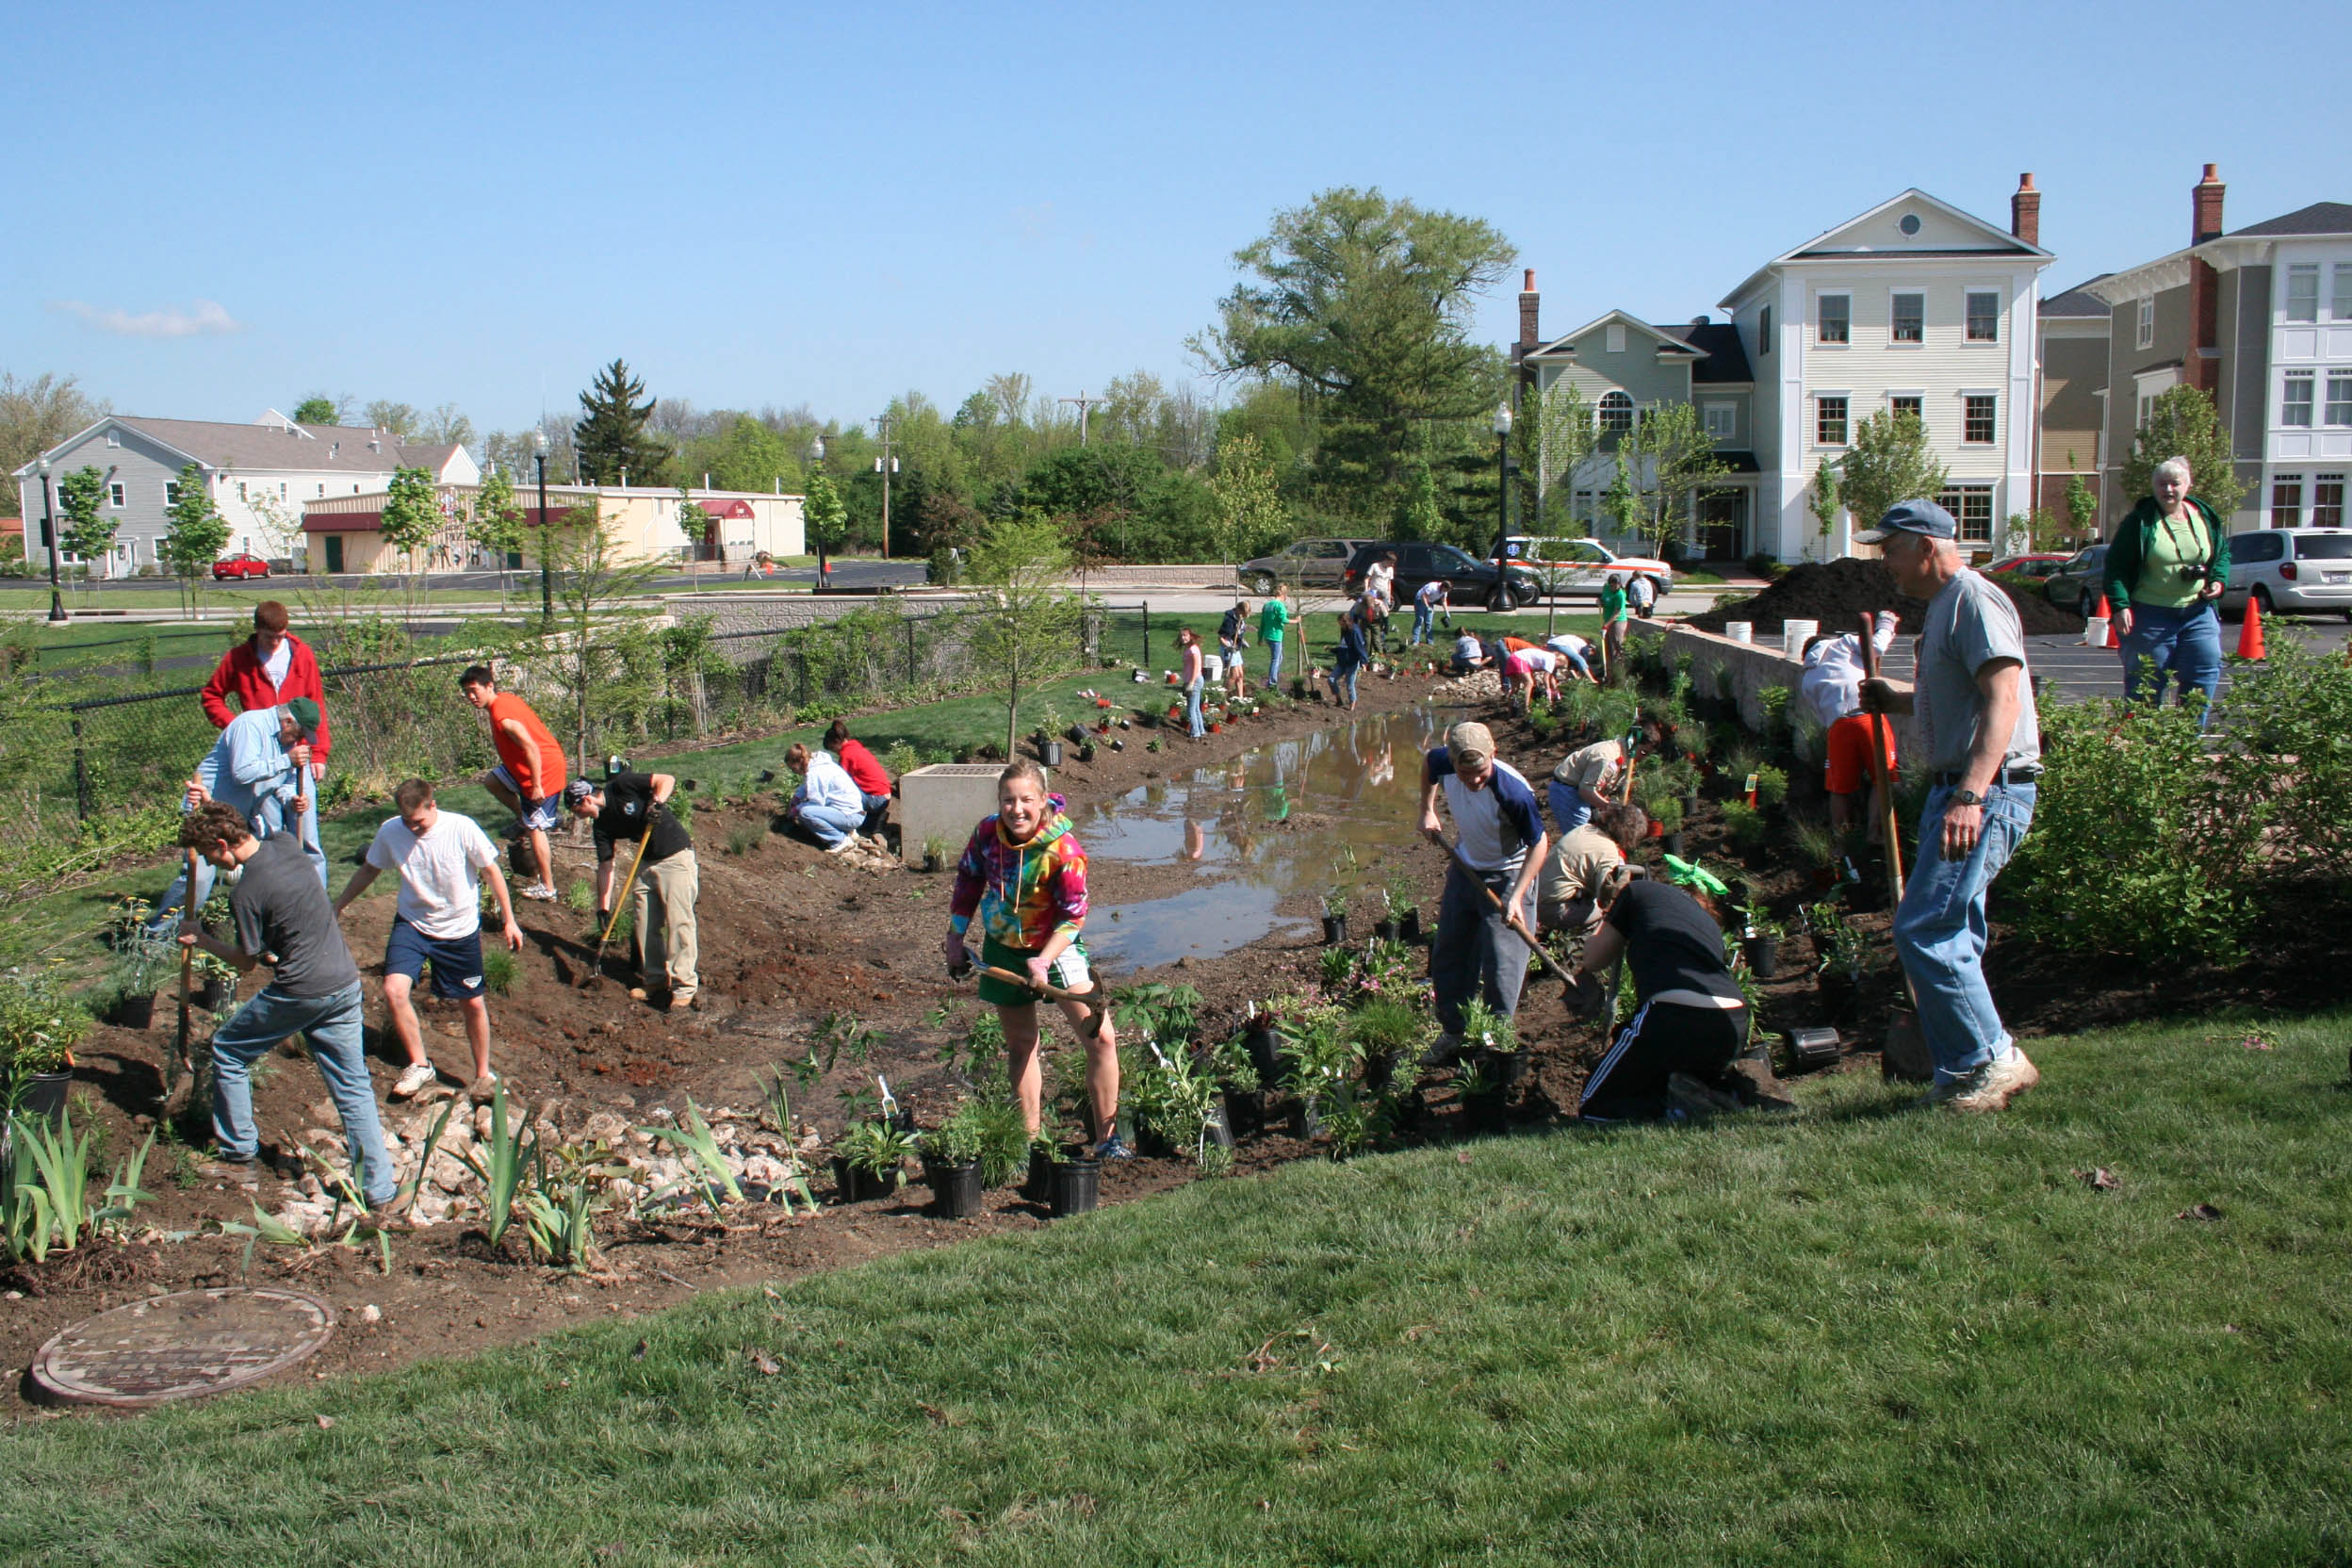
Source 1, the excerpt from Millennials Rising
This source describes what community service has meant for various generations, ranging from Selective Service in the early twentieth century to service learning today.

Slide 8
Source 2, the mission statement from Dalton School
This source offers an argument for community service based morality and a sense of responsibility to a community.
However, the statement is from a small private school.
Might this limit its wider application?

Slide 9
Source 3, “Volunteering Opens Teen’s Eyes to Nursing”
This source is quite positive and possibly persuasive if you are writing in support of community service.
However, it focuses on the experience of a seventh grader, which might not be relevant to high schools.

Slide 10
Source 4, on resume padding
This source is a good counterexample to Source 3.
It reports on the cynical attitude of students who perform community service specifically to bolster their college applications.
Would nationwide mandatory community service eliminate this issue?
Would it make it more difficult for truly altruistic (def: unselfish) students to distinguish themselves?

Slide 11
Source 5, on mandatory volunteerism
This source reports that requiring community service may discourage future involvement, making it less likely that volunteering will become a lifelong habit.
Does this finding ring true for you?
ORIGINS

Slide 12
Source 6, the graphs from Mark Hugo Lopez’s study
This source raises further questions about required community service.
Graph 1 shows that support for requiring such service is weakest among those currently in school and is evenly split among those over the age of twenty-one.
Does this finding suggest that community service is “good medicine” for high school students, who will eventually appreciate the experience?
Graph 2 shows that young people with greater levels of education (“Educationally Successful,” signifying completion of a BA or some college work, as opposed to only a high school education) are more likely to support a community service requirement in high school.

Slide 13
Formulating Your Position
Before you formulate your position, it might be helpful to take stock of the issues.

Slide 14
In analyzing the texts on community service, the following questions emerge:
Does requiring community service devalue it?
Does requiring it discourage future participation?
Does the positive experience that most volunteers have offset their initial reluctance to participate?
What influence does socioeconomic status play in such a requirement? For example, if students need to earn money in their free time, can required community service programs be designed to accommodate them?
How does a school system determine how may hours of service to require?
How would making community service mandatory affect the fact that many students volunteer for selfish reasons, namely, padding their resumes for college?
Notes:
These questions-and others you might have-illustrate the complexity of the issue and ensure that you do not develop an argument that is one-sided or polarized between yes and no.

Slide 15
These questions-and others you might have-illustrate the complexity of the issue and ensure that you do not develop an argument that is one-sided or polarized between yes and no.

Slide 16
Let’s brainstorm the complexities of one of your topics…

Slide 17
Thesis or Claim
Consider the following working thesis statements:
Notes:
With these questions in mind, you can begin to formulate a thesis, or claim, that captures your position on the topic.

Slide 18
Thesis #1
Community service can be extremely valuable in the development of both character and academics, but the negative effects of forcing students to participate by making it a graduation requirement more than offset the benefits.
What questions does this thesis address?
Notes:
Addresses the question: Does requiring community service devalue it? How would making community service mandatory affect the fact that many students volunteer for selfish reasons, namely, padding their resumes for college?

Slide 19
Thesis #2
Though students may not recognize the value of community service until later in life, high school should require community service to instill a sense of civic responsibility and encourage a lifelong habit of helping others.
Which sources could be used to support this thesis?
Notes:
Adresses questions:

Slide 20
Thesis #3
Required community service programs are beneficial to both the individuals who participate and the communities being served, as long as students have some choice in the type of service they engage in.
How does this thesis address the complexities of this topic?
qualifier

Slide 21
Your Synthesis Essay
Although you might want to tailor one of these working thesis statements to use in your essay, each one suggests a clear focus while acknowledging the complexities of the issues.

